Slide 1
400 Years
after the
First Thanksgiving
1621 - 2021

Slide 2
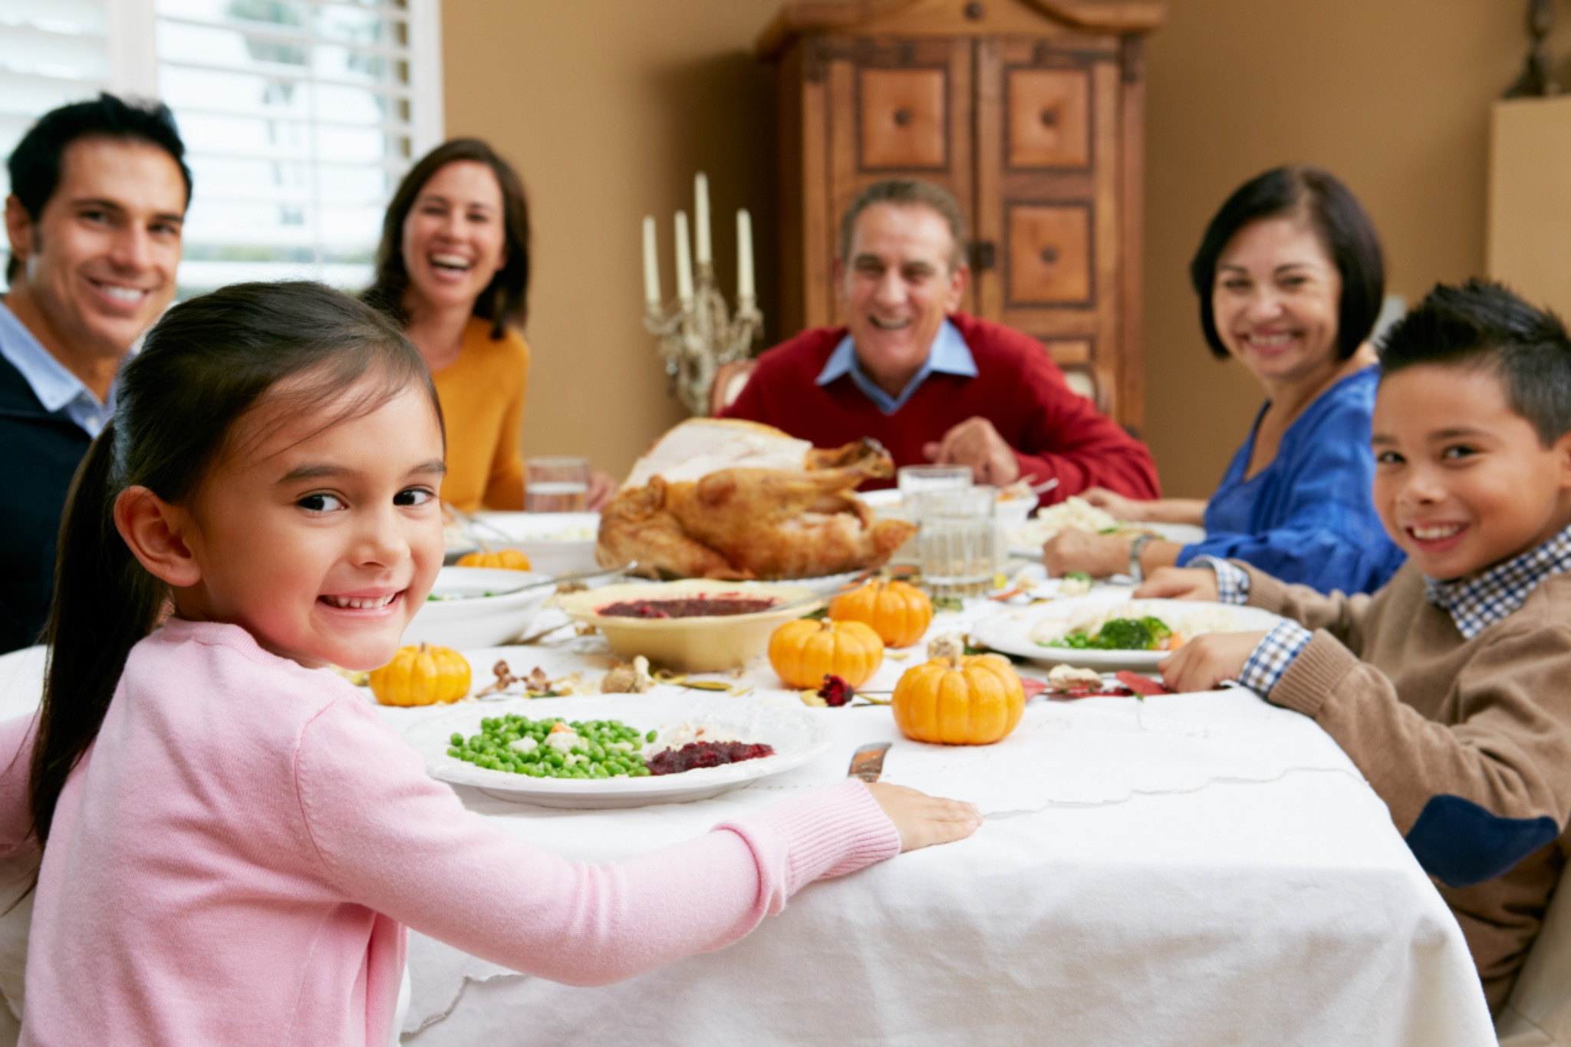
Party time! What are we celebrating?
Notes:
Why is Thanksgiving a holiday in America? We have to go back 400 years, before our country even existed, to find out the answer. It was exactly 400 years ago this year - 2021 - that the first Thanksgiving took place. Let’s find out where it happened, who was there, and what they were celebrating.

Slide 3
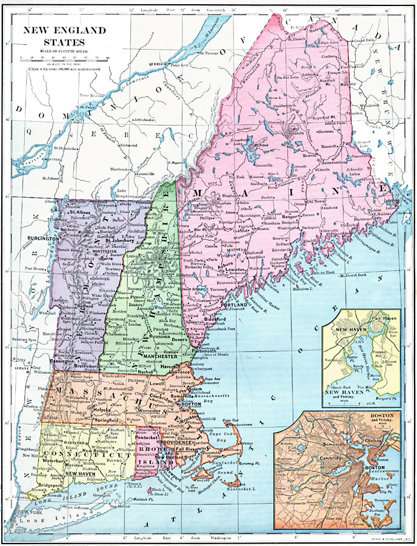
The place was called PLIMOTH, which today is spelled PLYMOUTH. Where in the world is that?
Notes:
Today Plymouth is a town in the state of Massachusetts in a section of the country called New England. It is on the East Coast next to the Atlantic Ocean. In 1621 Plymouth was a tiny village with only a few buildings and a few dozen people. This is a modern map that shows Plymouth on the left side of Cape Cod Bay. That is where the first immigrants decided to land and settle.

Slide 4
Who was at this party?
Notes:
Let’s look at this picture. Can anyone identify the people? [pause] Which ones are the Native People? Which ones are the Pilgrims from England? This painting was made in about 1900, so the artist did not really know how the people looked in 1620, but it gives us an idea based on what was written by the Pilgrims. So, how did the Native People and the Pilgrims get together?

Slide 5
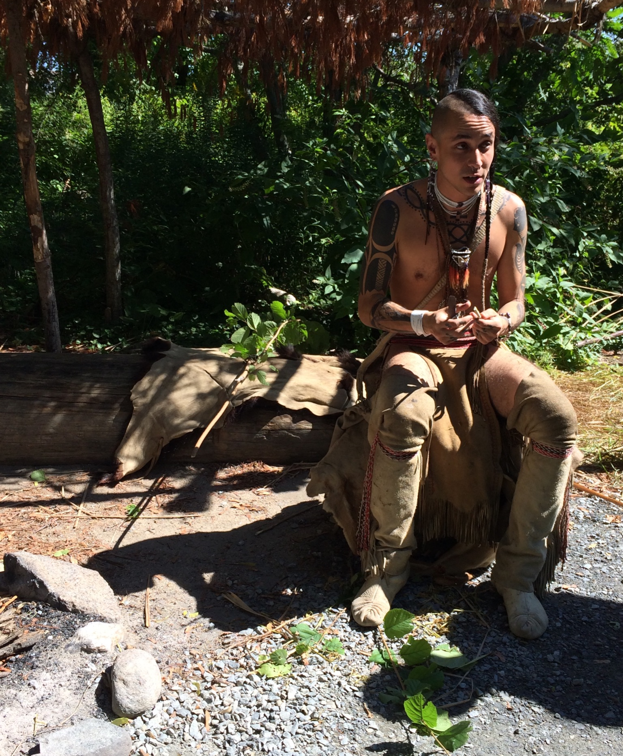
The Native People had been in the Plymouth area for thousands of years.
Notes:
The Native People in this area of Massachusetts were called the Pokanoket. For 12,000 years, the Native People had the land all to themselves. When the Europeans discovered the great continent of North America in about 1500, they called it the New World. They were interested in all the natural resources there, such as timber, fish and beavers. The Native People traded with the explorers and fishermen from Europe. Sadly, the Europeans brought diseases and the Native People had no natural protection from them. Sometimes the illnesses wiped out whole villages.That is what had happened at the place where the immigrants decided to settle, the place they called Plymouth.The few Native survivors had abandoned the site and it sat empty. This photograph was taken in 2014 of a young Native man working at the Plimoth Patuxet Museum.

Slide 6
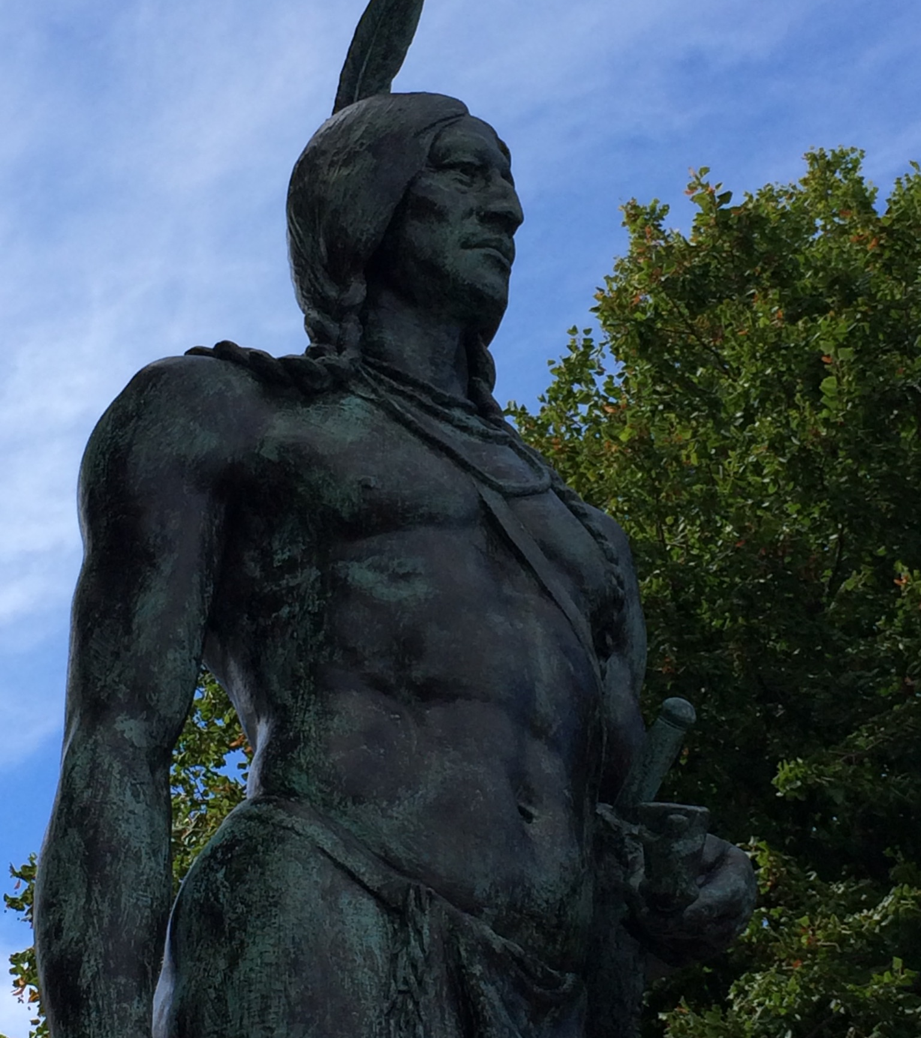
Massasoit
Chief of the Pokanoket
Notes:
Although there were no Native People living right at the site of Plymouth in 1620, there were about 40,000 Native People in the surrounding area. Their leader was Chief Massasoit. He was very powerful and highly respected, and we will come back to him in a few minutes to find out what he did for the Pilgrims. This is a photo of a statue of Chief Massasoit that stands in Plymouth.

Slide 7
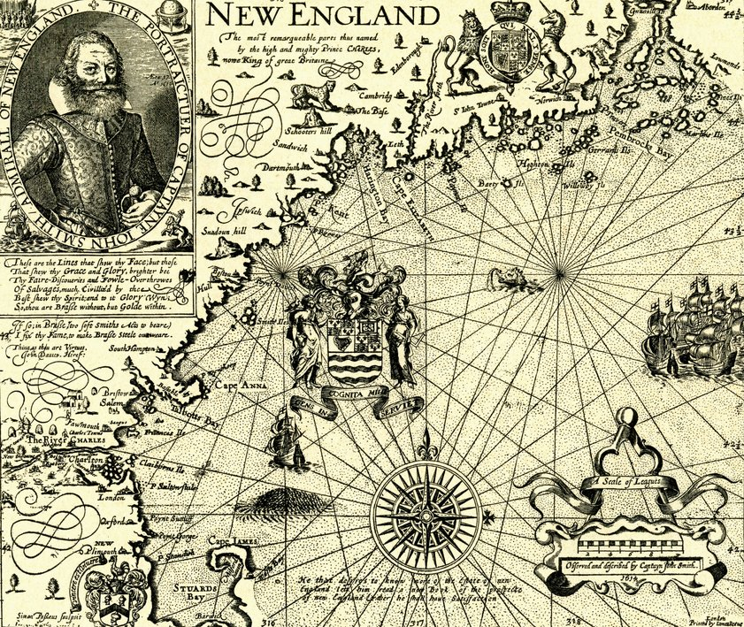
Captain John Smith’s Map of New England
Plymouth
Notes:
Some of those European explorers and adventurers we mentioned earlier made maps of the New World. The maps got people in England excited about the New World. This map was made by Captain John Smith in 1614, a few years before the Pilgrims landed in Plymouth.

Slide 8
What is a pilgrim?
A pilgrim is a person who goes on a journey, often to a foreign land, for a religious purpose.
The journey is called a pilgrimage.
Notes:
Now, how about the other people who were at this Thanksgiving party? Who were they? We call them Pilgrims. What is a pilgrim? The dictionary tells us that a “pilgrim” is a person who goes on a journey, often to a foreign land, for a religious purpose. A pilgrim could be a person at any time in history, in any land, and of any religion. Has your family ever traveled to worship at a special place, a temple or a cathedral? If so, you could call yourself a pilgrim. Why do we call the people who landed at Plymouth “pilgrims?”

Slide 9
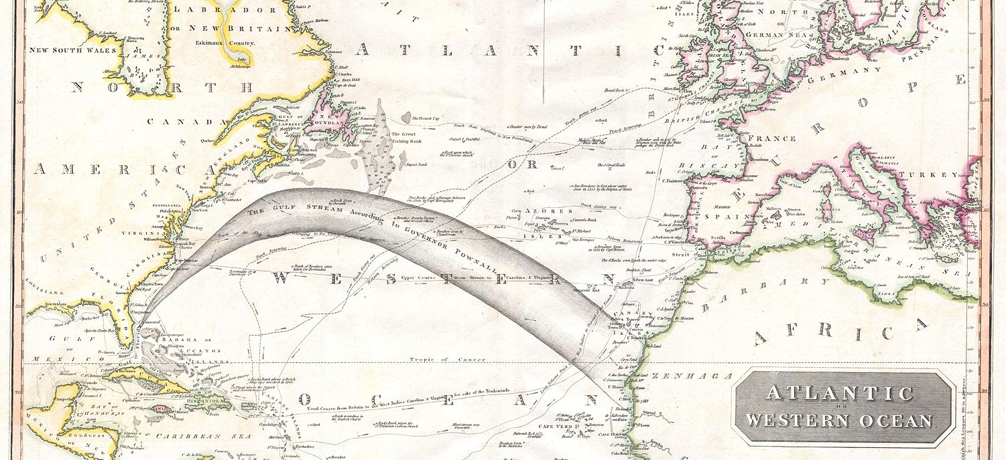
The Pilgrims journeyed across the Atlantic. Why?
Notes:
They are called pilgrims because they journeyed far from home for religious reasons. How far did they go? This map shows England on the upper right, that large island off the coast of Europe. The Pilgrims left England and sailed all the way to the coast of North America, a treacherous journey that took weeks and weeks. The starbursts show you where they began and where they ended. Do you wonder why they left their home?

Slide 10
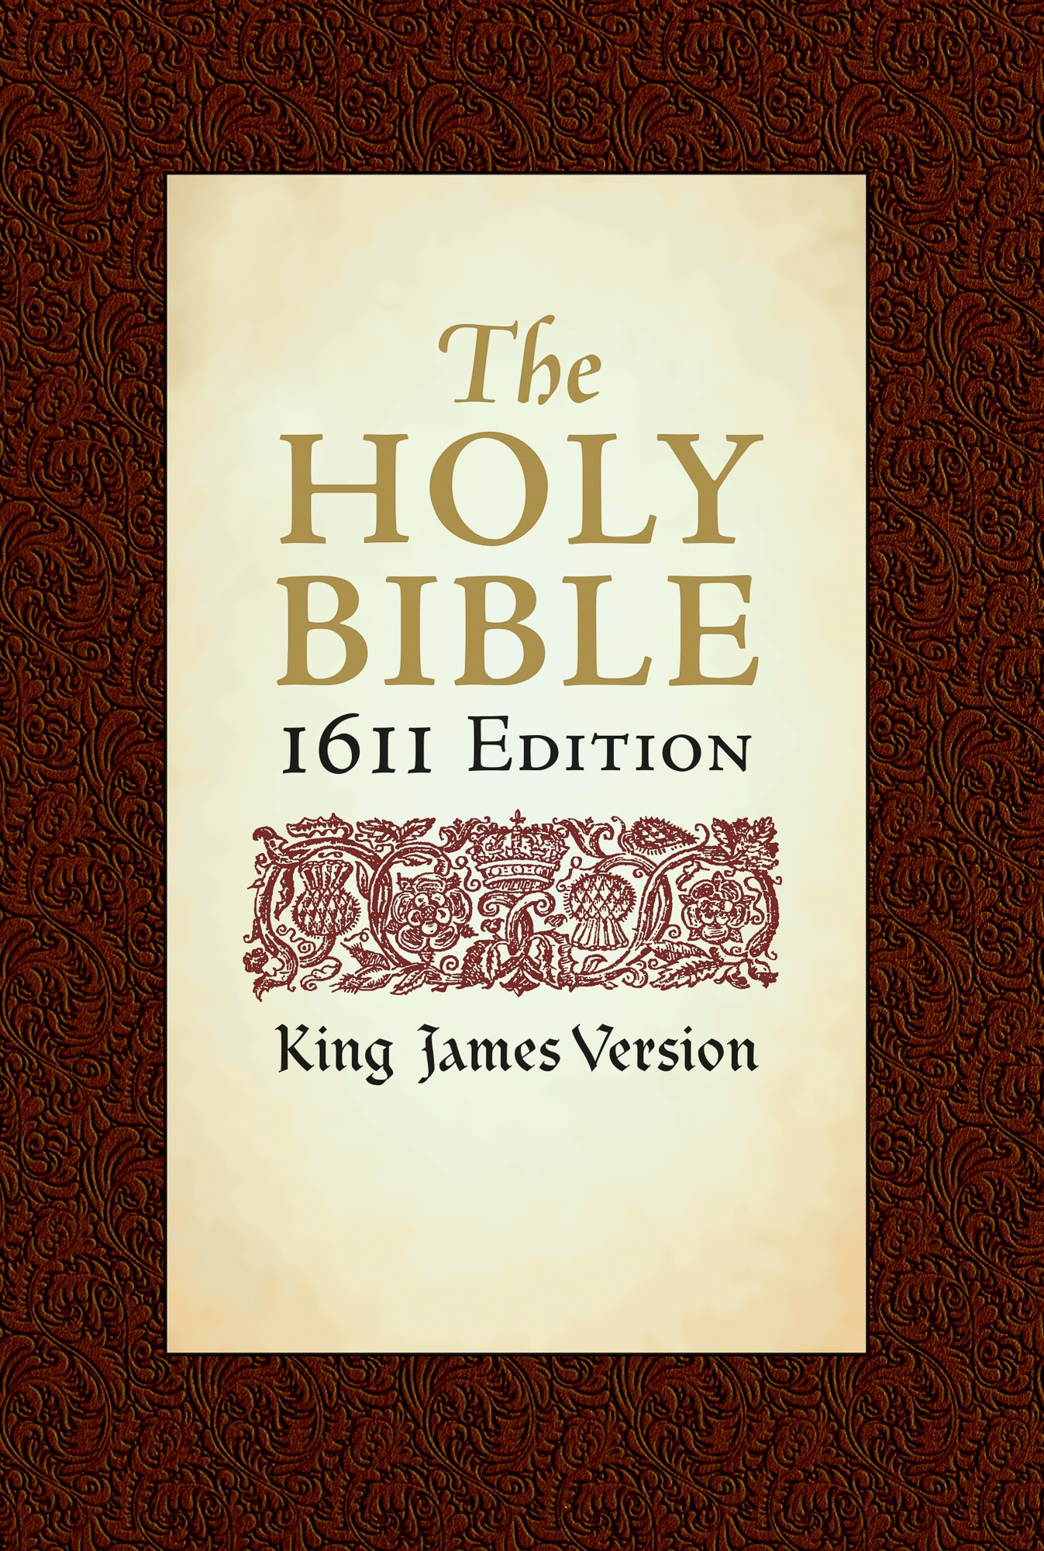
Reason #1
Religious freedom
Notes:
The first reason is about religion. The Pilgrims were English, and England was a Christian nation. The King of England said everyone had to worship at the Church of England, and if you didn’t, you could be arrested and put in jail. The Pilgrims thought the Church of England was wrong and they wanted to worship in their own way. They did not care about church buildings and they did not care for the rulers of the church, the priests and bishops. They wanted to read the Bible for themselves and live according to what the Bible told them. Because that was dangerous, even life-threatening, to do in England, they thought they should travel to this unknown place called the New World for religious freedom.

Slide 11
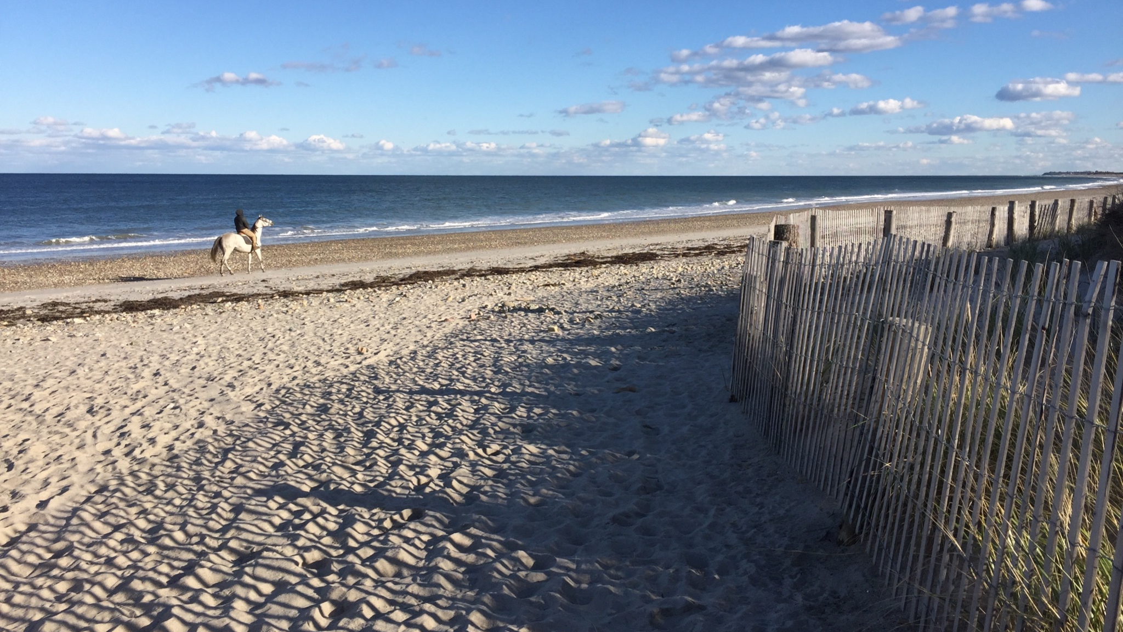
Reason #2
Opportunity
Notes:
The second reason also had to do with freedom - the freedom to live and work as they wished. People were excited about the opportunity to start a new life and build a new community in a brand new place. In England people were expected to stay put and do the same work their parents had done. There were not many ways to earn a living, and there was not much land available. The land already belonged to people, and you had to work for them instead of working for yourself. So some people wanted an opportunity to earn a living doing something different in a new, free place. This photo shows a beach on the Atlantic Ocean near Plymouth.

Slide 12
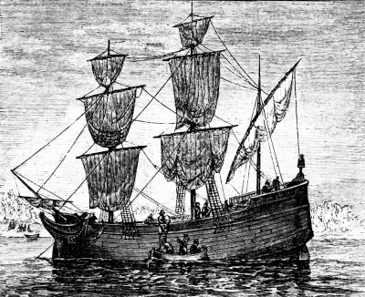
The Merchant Adventurers of London
The Mayflower
Notes:
A company called the Merchant Adventurers of London was formed in 1620 to send settlers to the New World. The settlers promised to send furs, fish, and lumber back to England to pay for their passage and to create a profit for the owners. The Merchant Adventurers hired the Mayflower and the crew and provided passage on the ship for the passengers. The deal was that the settlers would pay what they owed for seven years, then they could keep what they earned.

Slide 13
Who was on board the Mayflower?
50 men
18 men had wives, families or children with them. 32 men traveled alone.
21 women
11 were married with children on board. 10 women were single or without children.
31 children
Two more children were born on the ship.
Notes:
Of the 102 Pilgrims on board the Mayflower, there were 11 families with a mom and dad and children. There were also a few married couples who had no children, or they left their children in England with plans to send for them later. And there were some fathers and sons, who planned to send for the rest of the family after they were settled. Some of the single people were servants who worked for the families. Two babies were born on the ship. One was born on the crossing, and he was named Oceanus, and one was born on the ship when it was in the harbor.

Slide 14
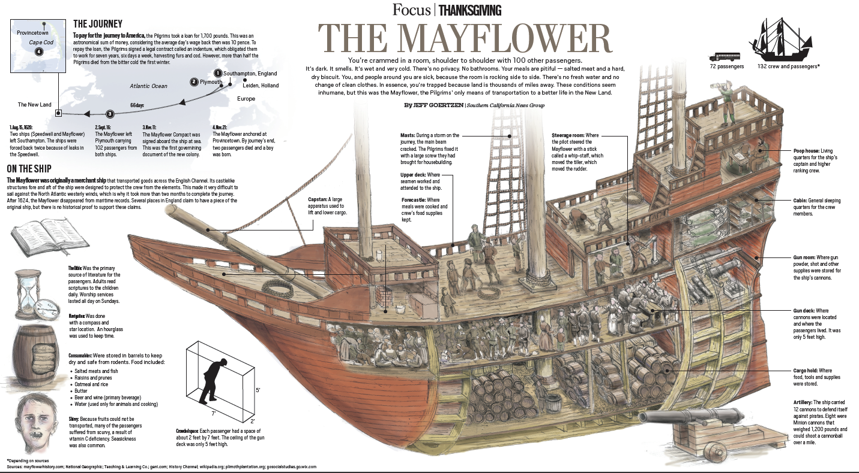
Notes:
This drawing shows a cross-section of the Mayflower. Where is the food stored? Where do the people sleep and eat? The passengers did not have much room and could not bring very many belongings. If you could bring only one backpack of personal things (besides your clothes) to start a new life, what would you bring?

Slide 15
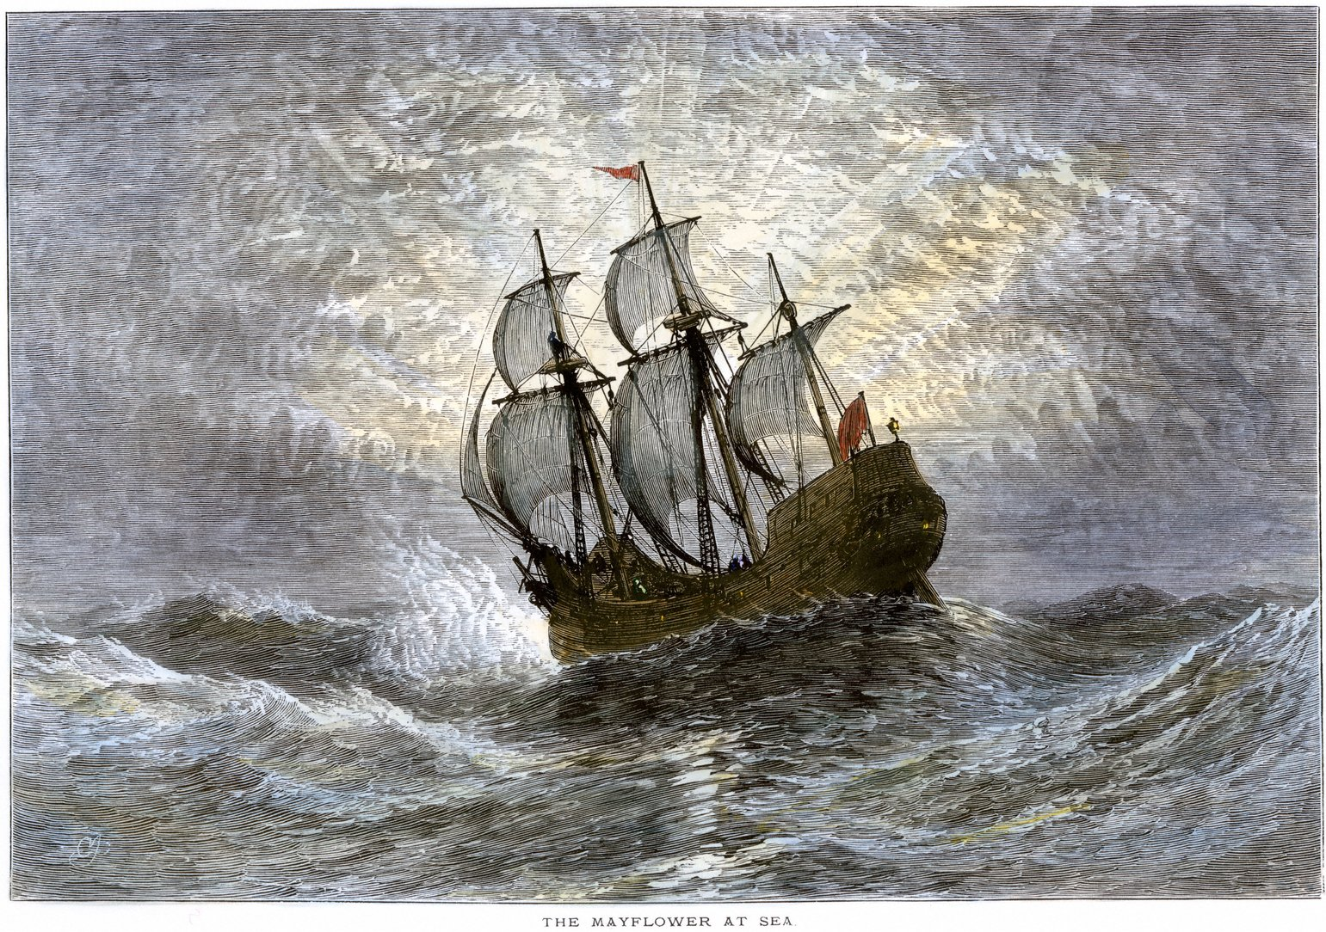
How was the voyage?
Notes:
The Mayflower was supposed to leave England during the summer, but it was delayed until September. It was at sea for 65 days. That’s more than nine weeks! The ship weathered many storms because it was so late in the season, and the people living below the decks suffered. Imagine how dark and crowded and smelly it was down there. Many of the passengers were seasick.

Slide 16
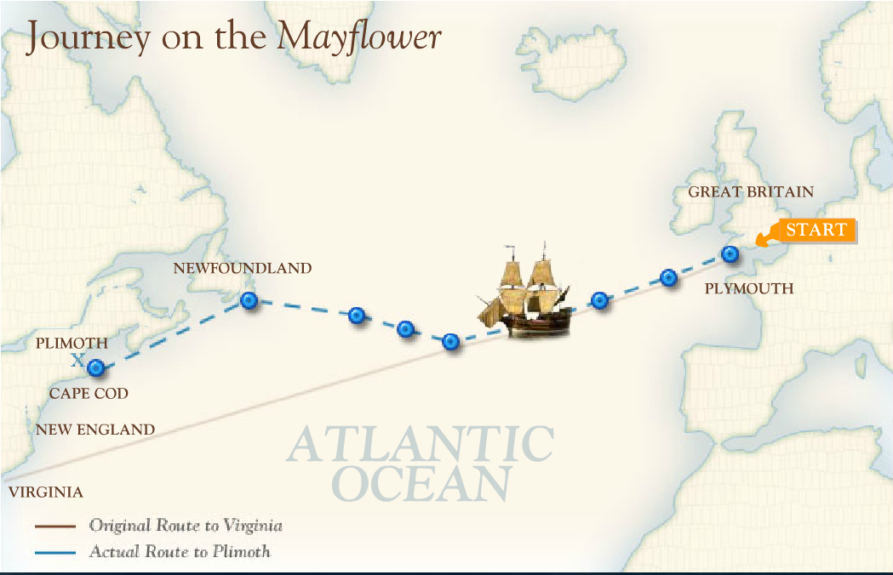
Notes:
The Mayflower did not end up where it was supposed to. If you follow the straight line from the START in England, you see that it was supposed to land in a place called Virginia. But if you follow the blue dots, you can see that the ship was blown off course and ended up north of where it was supposed to go. Let’s look at another map.

Slide 17
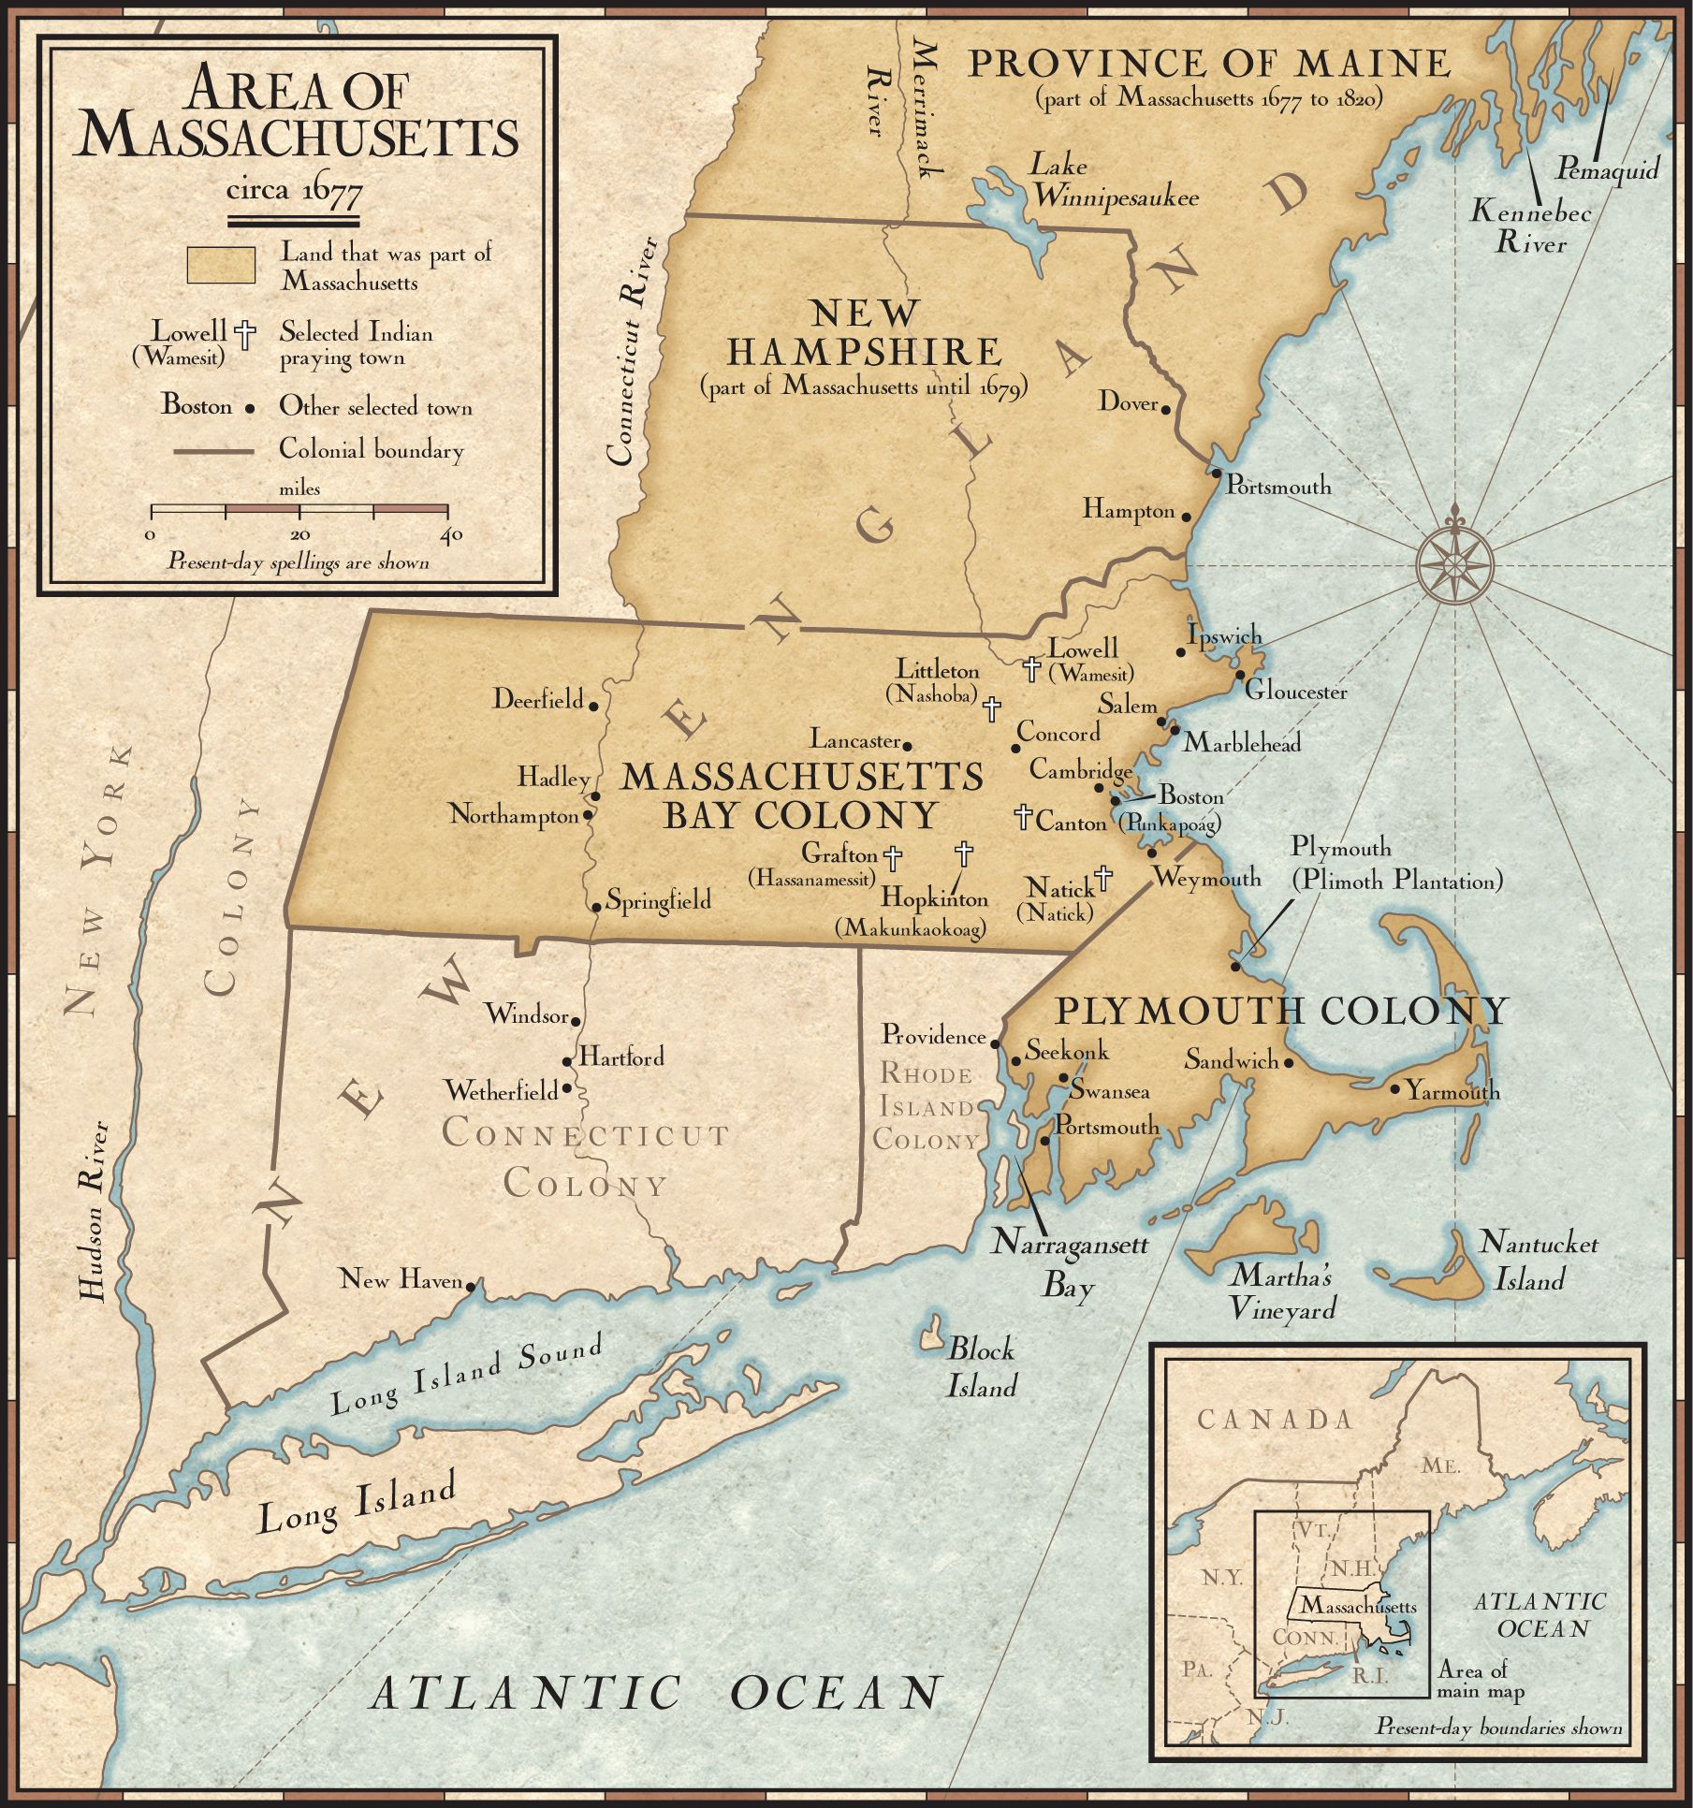
Notes:
This map shows in more detail where the Mayflower landed. Can you find Plymouth? If you leave Plymouth and go out around the Cape and down the coast, you eventually come to Long Island and the Hudson River. That is where the Mayflower was supposed to land. It is 200 miles south of Plymouth. Today we call this area New York, but the Pilgrims called it Virginia. The captain made the decision that the ship would not make it that far because of the cold winter winds and the rough seas. He was worried that so many people were getting sick and he wanted to get them on land. First, he anchored at the tip of Cape Cod on November 11. For a month, the men explored the area looking for the best place to settle. On December 16, 1620, the Mayflower anchored in Plymouth Harbor.

Slide 18
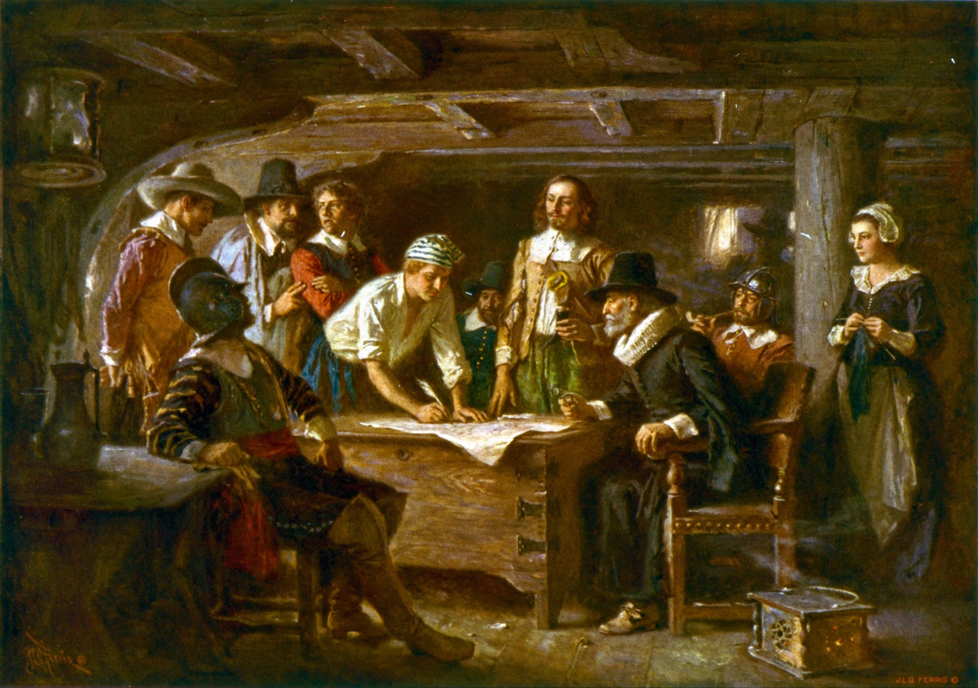
Signing the Mayflower Compact 1620
by Jean Leon Gerome Ferris 1899
Notes:
Since they had not arrived in Virginia as planned, the Pilgrims realized that they were not obligated to stick together. They were facing a vast unknown wilderness, winter was upon them, and they were low on food and supplies. Also, many people were sick. Since they didn’t have a contract, should they stick together or go their separate ways? They argued about it. The leaders on the ship wanted people to stay together to improve their chances of survival. They convinced people to elect a governor and to write an agreement that would bind them together. The governor said no one could go ashore until the men signed the document. It is true that only men signed the document because, 400 years ago, women did not participate in government or enjoy the right to vote. Things are very different today! This picture shows one young man signing his name to the Mayflower Compact. What was the agreement?

Slide 19
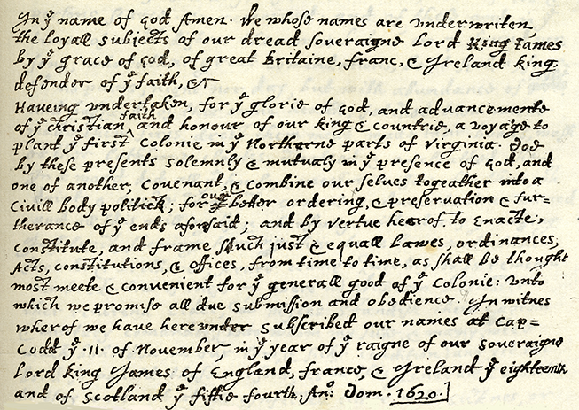
The Mayflower Compact
Notes:
The Mayflower Compact was a promise that the men would make laws for the general good of the colony, they would follow the laws, and they would obey the elected leaders. 41 men signed their names to the Mayflower Compact. Many people think that the Mayflower Compact provided the foundation of American freedoms that was spelled out later in the Constitution. Remember, the Pilgrims were all from England, where the King made the laws, not the people. The Mayflower Compact was an extraordinary thing. You might notice that the handwriting and the spelling are different from the way we write today. Styles have changed, and they wrote with long feathers called quills that were dipped in ink. Here is the text:
In the name of God, Amen. We whose names are under-written, the loyal subjects of our dread sovereign Lord, King James, by the grace of God, of Great Britain, France, and Ireland King, Defender of the Faith, etc.
Having undertaken, for the glory of God, and advancement of the Christian faith, and honor of our King and Country, a voyage to plant the first colony in the northern parts of Virginia, do by these presents solemnly and mutually, in the presence of God, and one of another, covenant and combine our selves together into a civil body politic, for our better ordering and preservation and furtherance of the ends aforesaid; and by virtue hereof to enact, constitute, and frame such just and equal laws, ordinances, acts, constitutions and offices, from time to time, as shall be thought most meet and convenient for the general good of the Colony, unto which we promise all due submission and obedience. In witness whereof we have hereunder subscribed our names at Cape Cod, the eleventh of November [New Style, November 21], in the year of the reign of our sovereign lord, King James, of England, France, and Ireland, the eighteenth, and of Scotland the fifty-fourth. Anno Dom. 1620.

Slide 20
Being thus arrived in a good harbor and brought safe to land, they fell upon their knees & blessed the God of Heaven … Governor William Bradford
Notes:
William Bradford, who later became the governor, was a Pilgrim on board the Mayflower. Years later, he wrote about how they felt arriving in the New World: “Being thus arrived in a good harbor and brought safe to land, they fell upon their knees & blessed the God of heaven, who had brought them over the vast & furious ocean, and delivered them from all the perils & miseries thereof, again to set their feet on the firm and stable earth, their proper element … they had now no friends to welcome them, nor inns to entertain or refresh their weatherbeaten bodies, no houses or much less towns to repair to, to seek for succour … What could not sustain them but the spirit of God & his grace?” In your own words, how would you describe the way the Pilgrims felt when they landed in the New World?

Slide 21
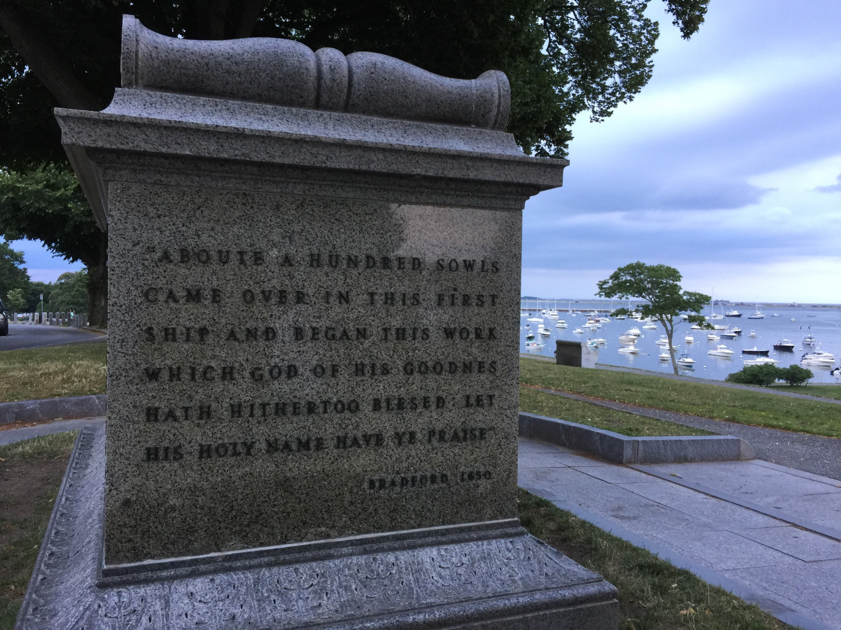
Notes:
Hundreds of years later, a monument was erected in Plymouth in honor of the Pilgrims. You can see Plymouth Harbor in the background. These are more words from Governor William Bradford: “About a hundred souls came over in this first ship and began this work which God of his goodness hath hitherto blessed: Let his Holy Name have the praise.” What do you think happened to this tribe of 100 people in the weeks to come?

Slide 22
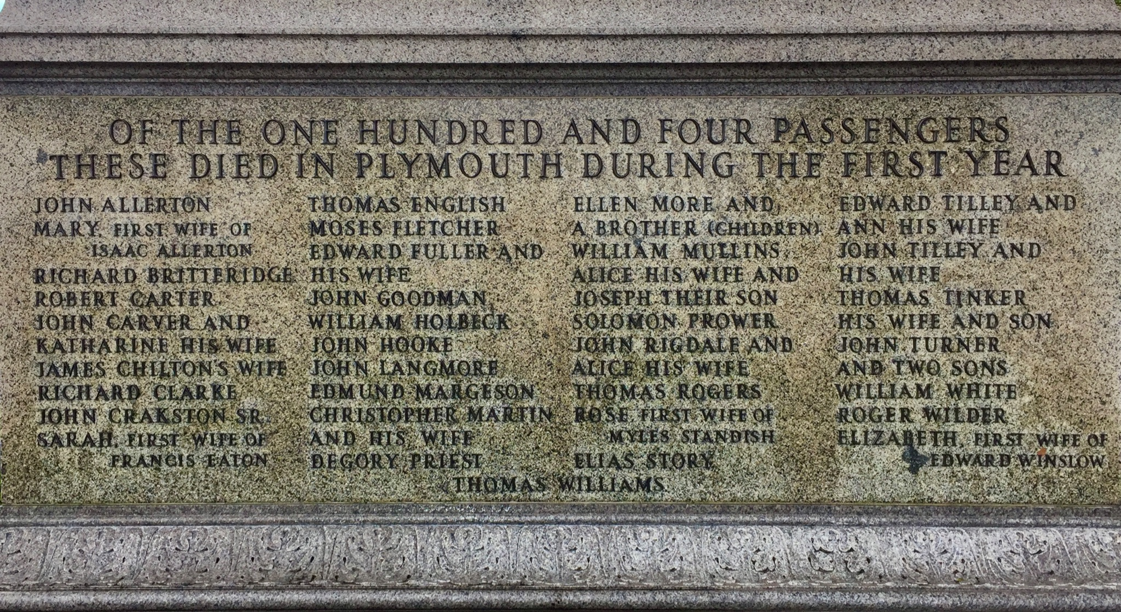
#1. Half the people died in a few months.
Notes:
Half of the 102 men, women and children who sailed from England died in the first few months. These are the names of the people who died early in 1621 and were buried in unmarked graves. The Pilgrims were busy trying to stay alive, and they could not make caskets and erect gravestones. Also, they knew the Native People were watching them, and they did not want them to know how many people had died.

Slide 23
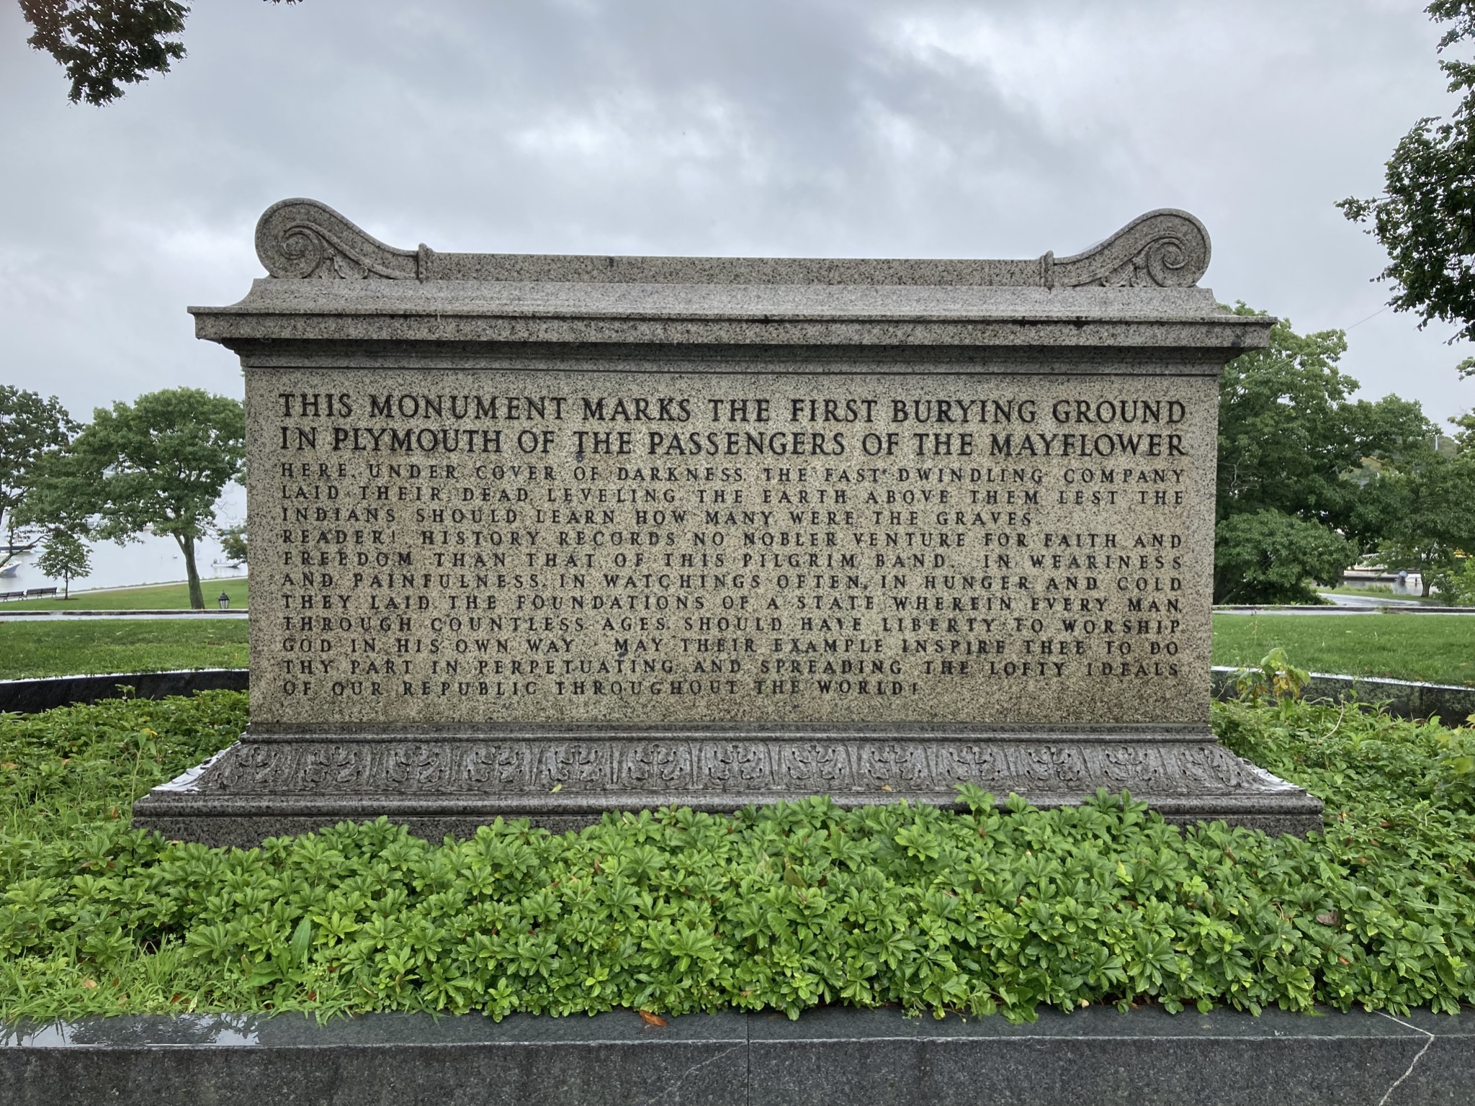
Notes:
This side of the monument reads: This monument marks the first burying ground in Plymouth of the passengers of the Mayflower. Here, under cover of darkness, the fast dwindling company laid their dead. Leveling the earth above them lest the Indians should learn how many were in the graves. Reader, history records no nobler venture for faith and freedom than that of this pilgrim band. In weariness and painfulness, in watching often, in hunger and cold, they laid the foundations of a state wherein every man through countless ages should have liberty to worship God in his own way. May their example inspire thee to do thy part in perpetuating and spreading the lofty ideals of our republic throughout the world.

Slide 24
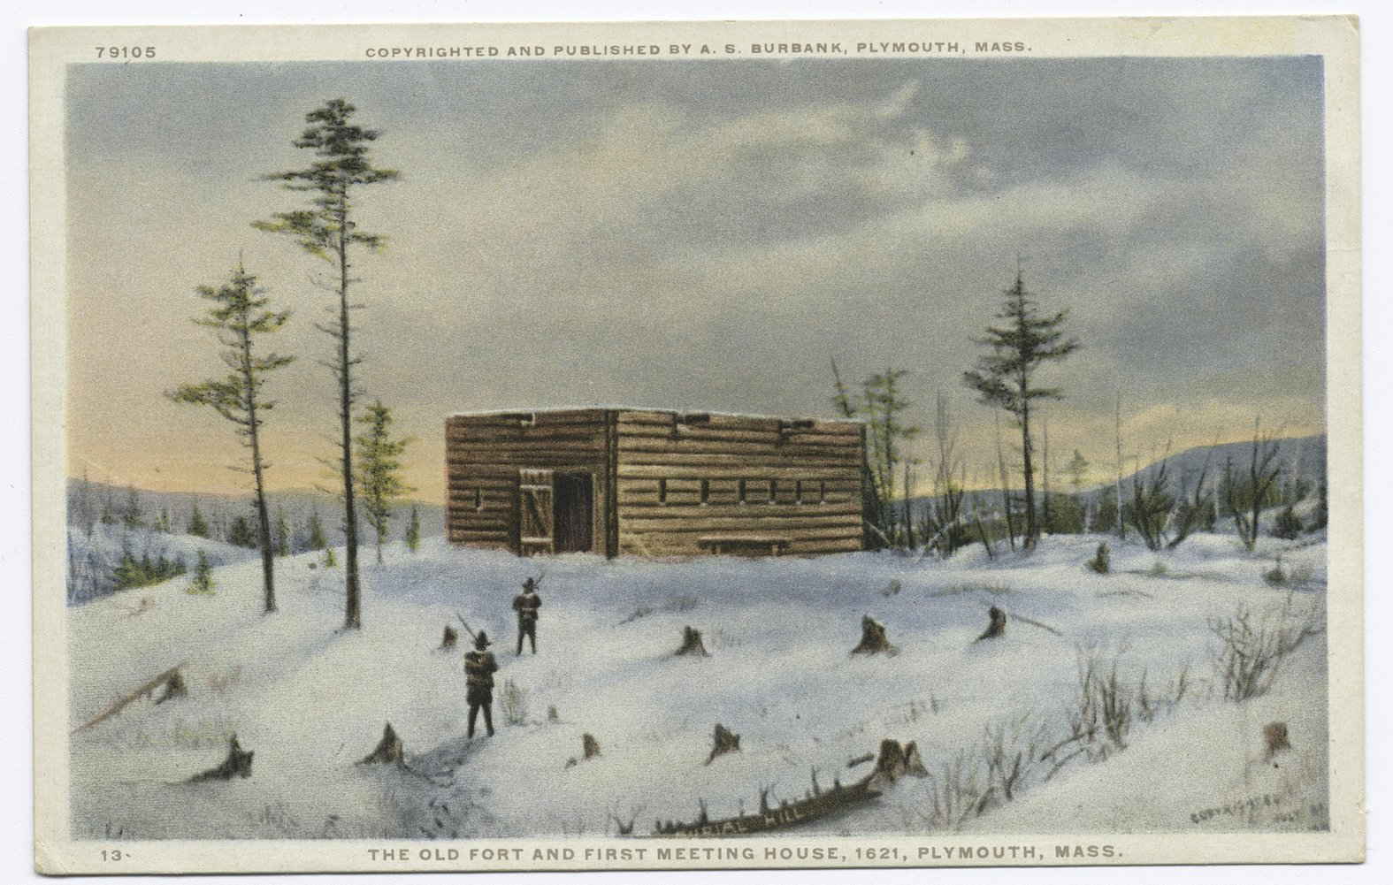
#2. They built a few structures.
Notes:
It was a bitter cold winter. The Pilgrims managed to build a few structures that protected people from the snow, ice and wind. This is a drawing of the First Fort and Meetinghouse. When the Mayflower returned to England in April, not one of the Pilgrims decided to go back. They were committed to building a village.

Slide 25
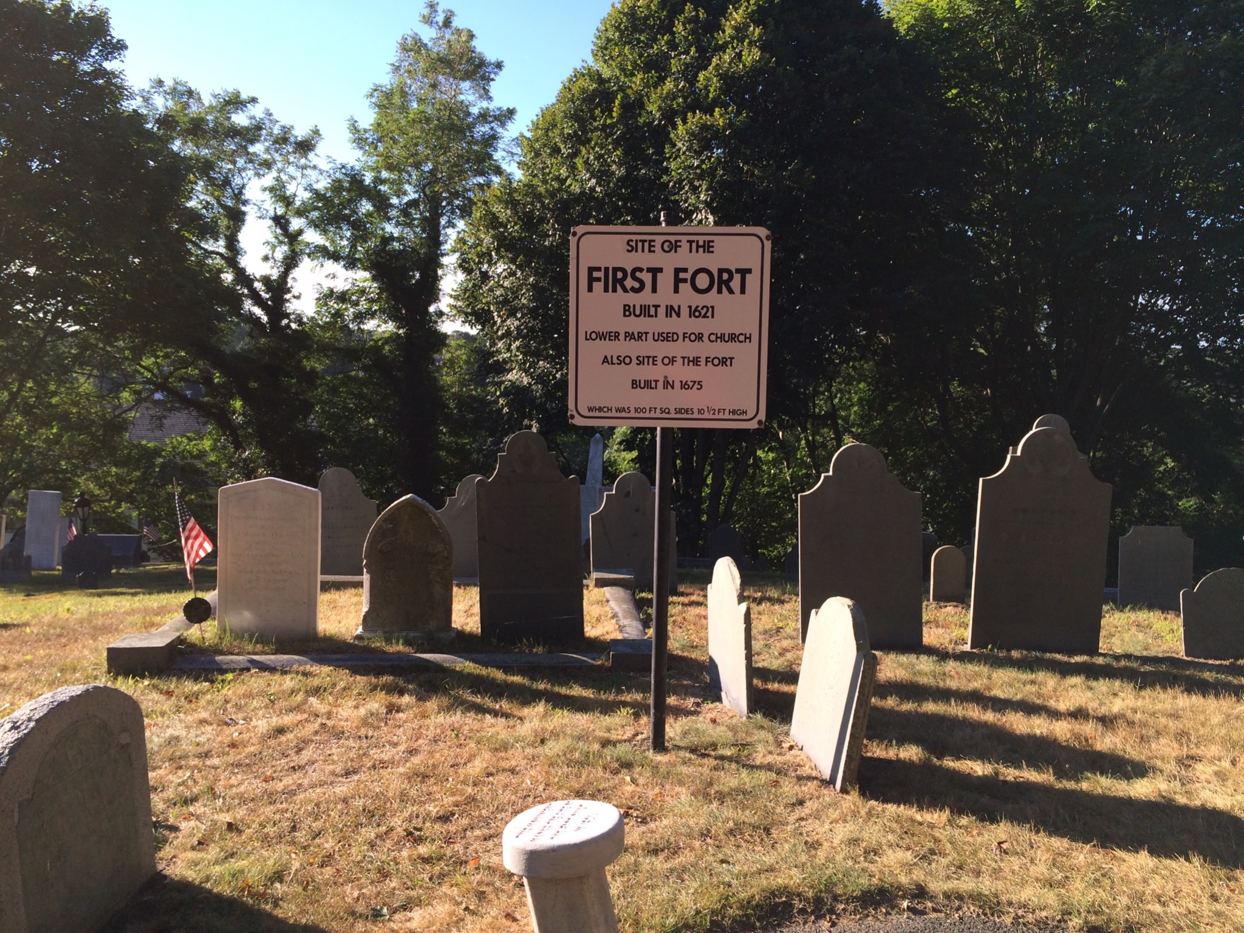
Site of the FIRST FORT built in 1621
Notes:
The first building the Pilgrims built was the fort you saw on the last slide. The pilgrims needed one place they could gather in safety and be protected from the winter and from anyone who would do them harm. The building no longer exists, but today the location is marked in the middle of a large cemetery.

Slide 26
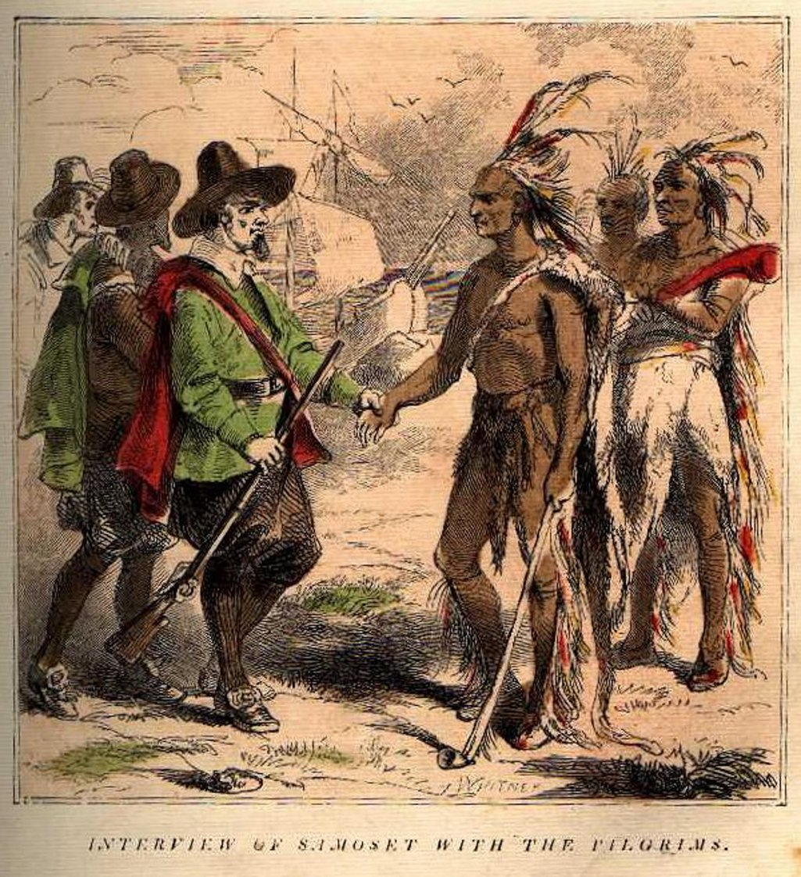
#3. They met the Native People.
Notes:
The Native People watched the Pilgrims for several months, but did not approach them right away. They were familiar with Europeans because they had been trading with them along the coast for several generations. This picture shows a chief named Samoset greeting a Pilgrim. Samoset had learned some English from talking to explorers and fishermen. He was the first Native to speak to the settlers. He walked into the settlement on March 16, 1621, and said, “Welcome, Englishmen!” Then he asked for a beer and stayed overnight for a visit. Samoset returned on March 22, 1621, with another Indian named Squanto. Squanto spoke good English because he had been captured and taken to England for several years. Squanto arranged a meeting with Chief Massasoit.

Slide 27
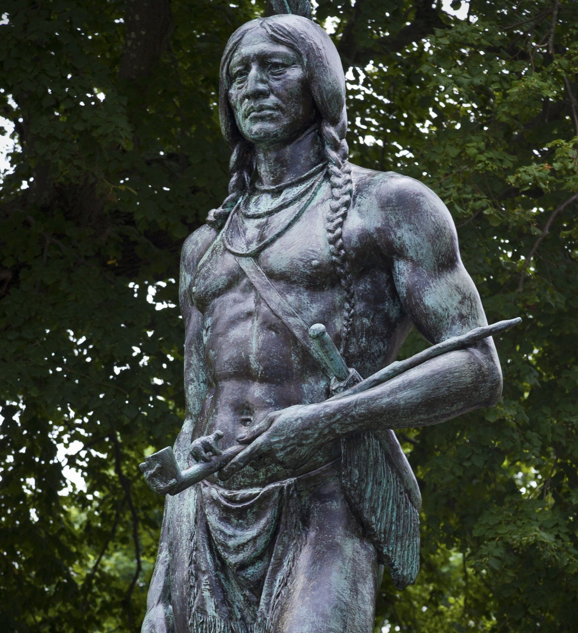
Chief Massasoit and the Pilgrims helped each other.
A statue of Chief Massasoit
looks over Plymouth Harbor.
Notes:
Chief Massasoit was the leader of the Pokanoket people. Chief Massasoit saw that the Pilgrim settleres included women and children. Before this, the only white people he had seen had been men. He saw that these people meant to settle permanently, and he considered what to do. Massasoit desperately needed military support against hostile Indian tribes. He had lost a lot of people to the sickness brought by the white adventurers, and his enemies were bigger and stronger, so he decided to make a treaty with the Pilgrims. He and his chiefs met with Pilgrim leaders, and they promised to treat each other justly and fight for each other. Squanto translated for them and advised both Massasoit and the Pilgrims as they learned to live alongside each other and protect each other.

Slide 28
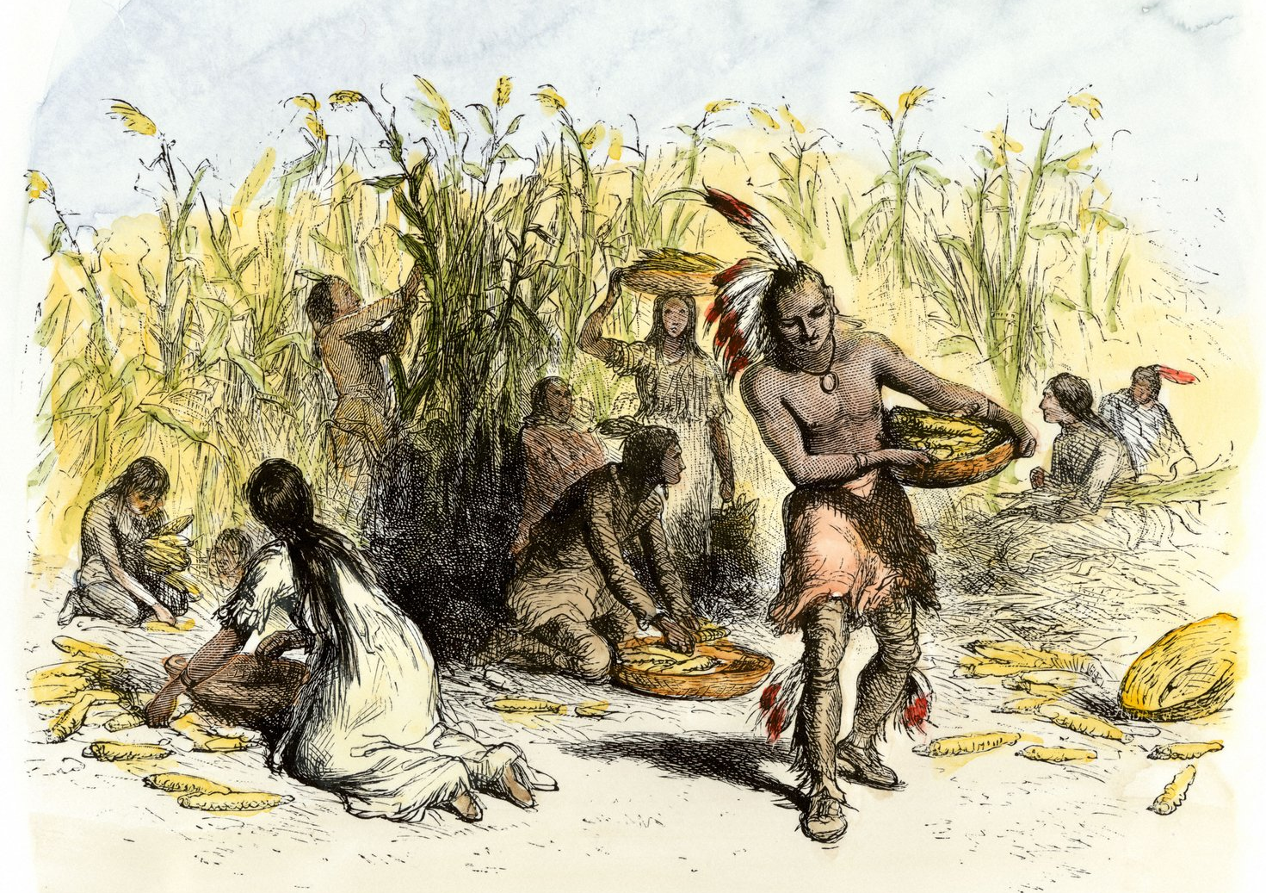
Native Americans Harvesting Maize
Notes:
The Native People were, of course, very good at fishing, hunting, and raising crops. They gave the Pilgrims seeds and showed them how, when and where to plant them. By the end of the summer, the Pilgrims had food to harvest.

Slide 29
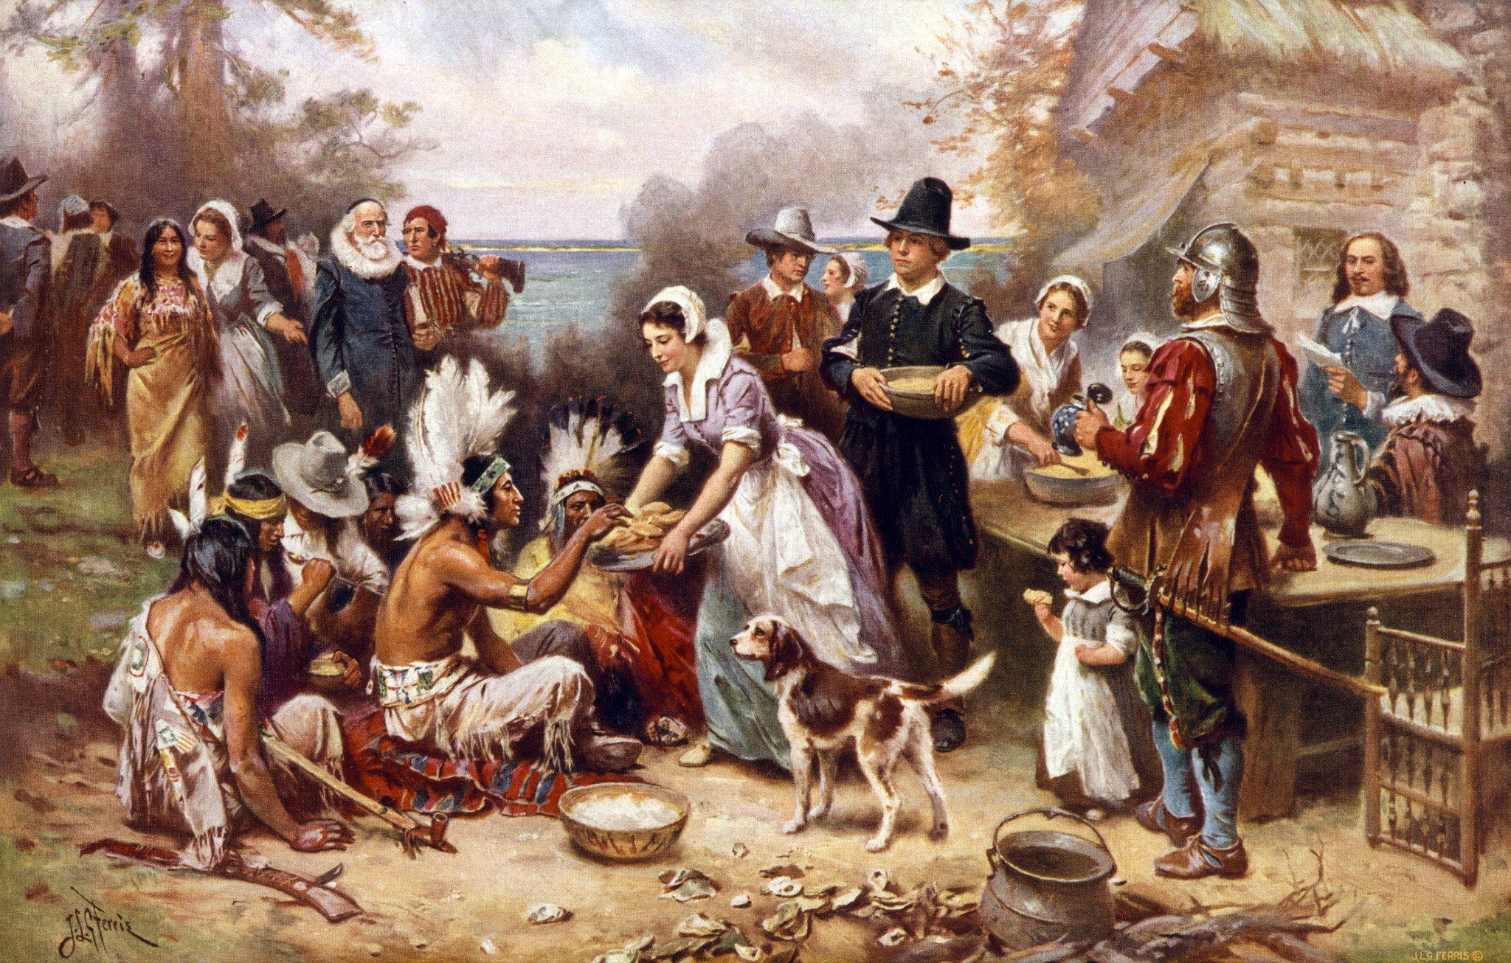
Our harvest being gotten in, our governor sent four men on fowling, that so we might after a special manner rejoice together … many of the Indians coming amongst us … Edward Winslow, Pilgrim
Notes:
Almost one year after landing in Plymouth, in September 1621, the Pilgrims had managed to harvest some corn, barley and other crops, thanks to Squanto and other Pokanoket. They also hunted ducks, geese and turkeys, which were plentiful during the fall season. For the first time, they had an abundance of food, and they decided to have a harvest festival. There were just about 50 Pilgrims who had survived, and soon Massasoit and 90 of his men joined them, bringing five killed deer. The Native People stayed for several days of feasting. The two groups camped together, roasted meat over the fires, and celebrated their survival.

Slide 30
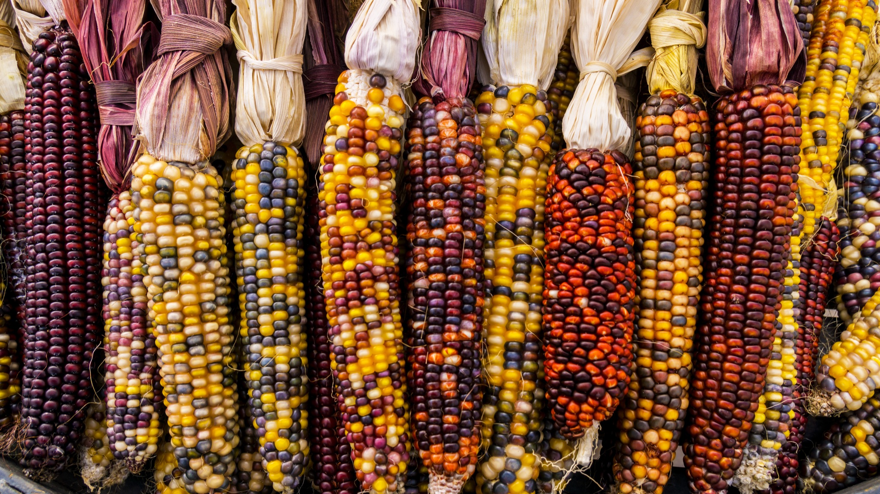
Why do we celebrate Thanksgiving?
Notes:
The Pilgrims and the nearby Native People established relations and treaties within a few months. There is no doubt that the Pilgrims would have died of natural causes without help from the Pokanokets. It is also true that the Native People could have slaughtered the Pilgrims, but they didn’t. Instead, the Pilgrims and the Pokanokets supported each other and lived as peaceful neighbors for 50 years. In the years to follow, the quest for land and resources would lead to wars and betrayals between the European immigrants and the Native People. Thanksgiving is the beginning of the story, not the end of the story. The Thanksgiving celebration is a reminder that all Americans, with diverse backgrounds, experiences and cultures, are capable of working together toward shared goals. Thanksgiving is also a harvest festival that celebrates the bounty of the earth and the survival of the people. Thanksgiving celebrates a relationship with the land that can provide such a rich harvest. Having a feast and giving thanks were natural to both the English and the Native People.

Slide 31
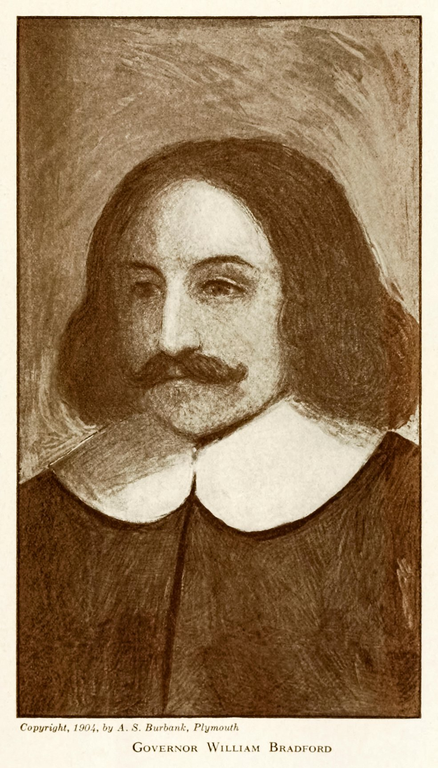
May not and ought not the children of these fathers rightly say: Our fathers were Englishmen which came over this great ocean, and were ready to perish in the wilderness; but they cried unto the Lord, and He heard their voice and looked on their adversity.
William Bradford, Governor and author of Of Plimoth Plantation
Notes:
Thanksgiving reminds us that the Pilgrims were strangers to this land. They left their homes and risked losing everything, even their lives.

Slide 32
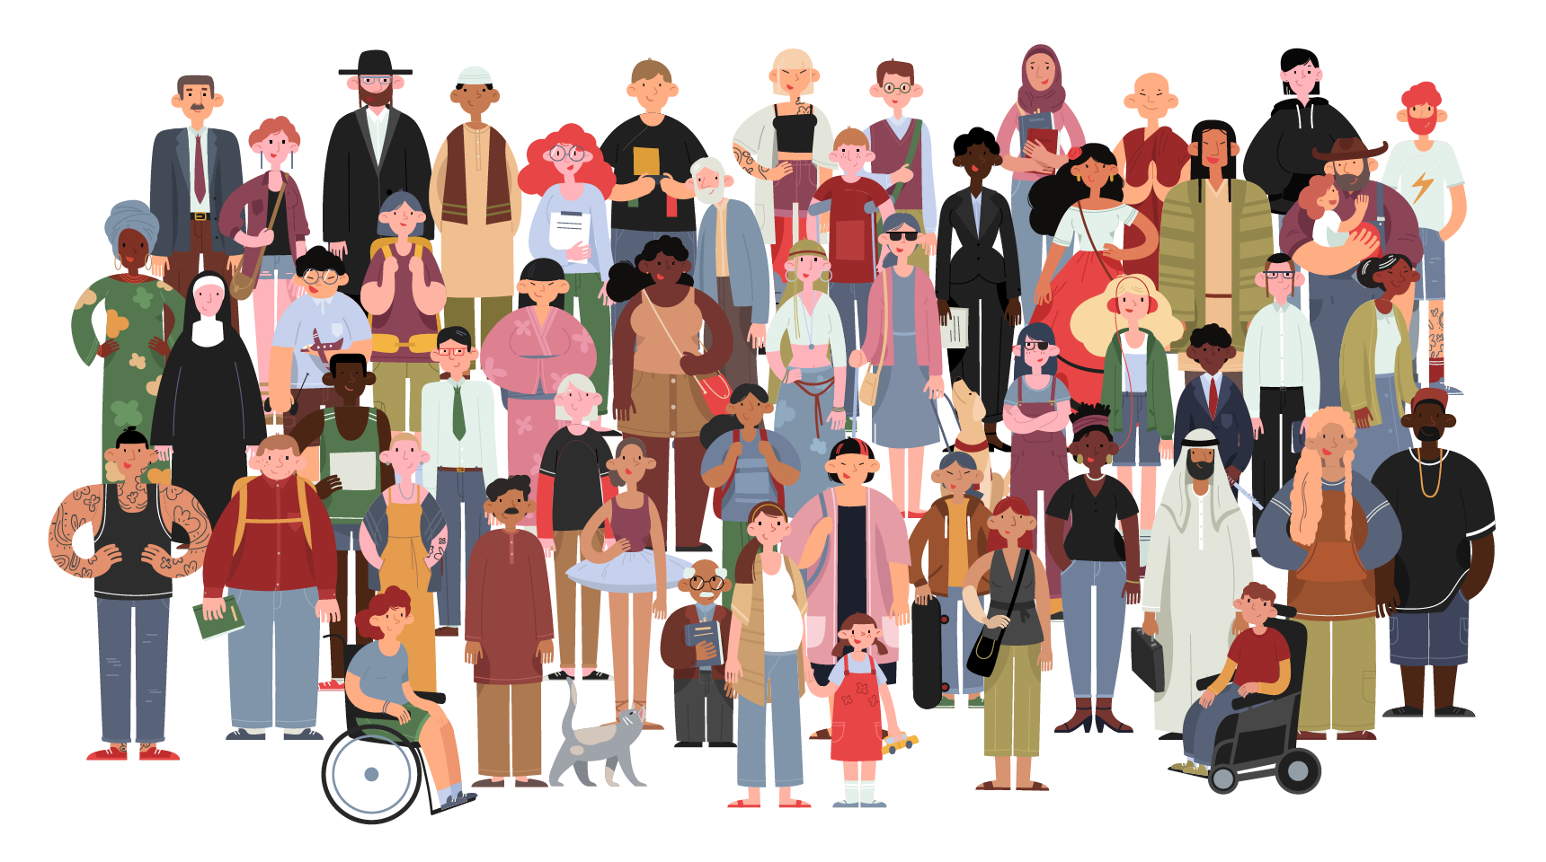
Notes:
Their story is the first immigrant story of America, and it ties into America’s history of immigration, one that continues to this day. Our nation’s immigrant stories are not just about a desire for more freedom and a better life, but also about taking risks and being committed.

Slide 33
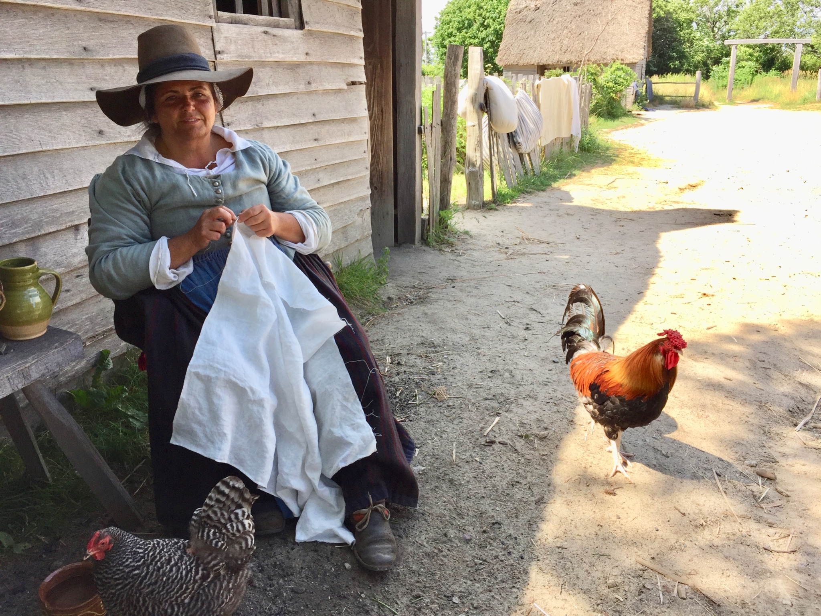
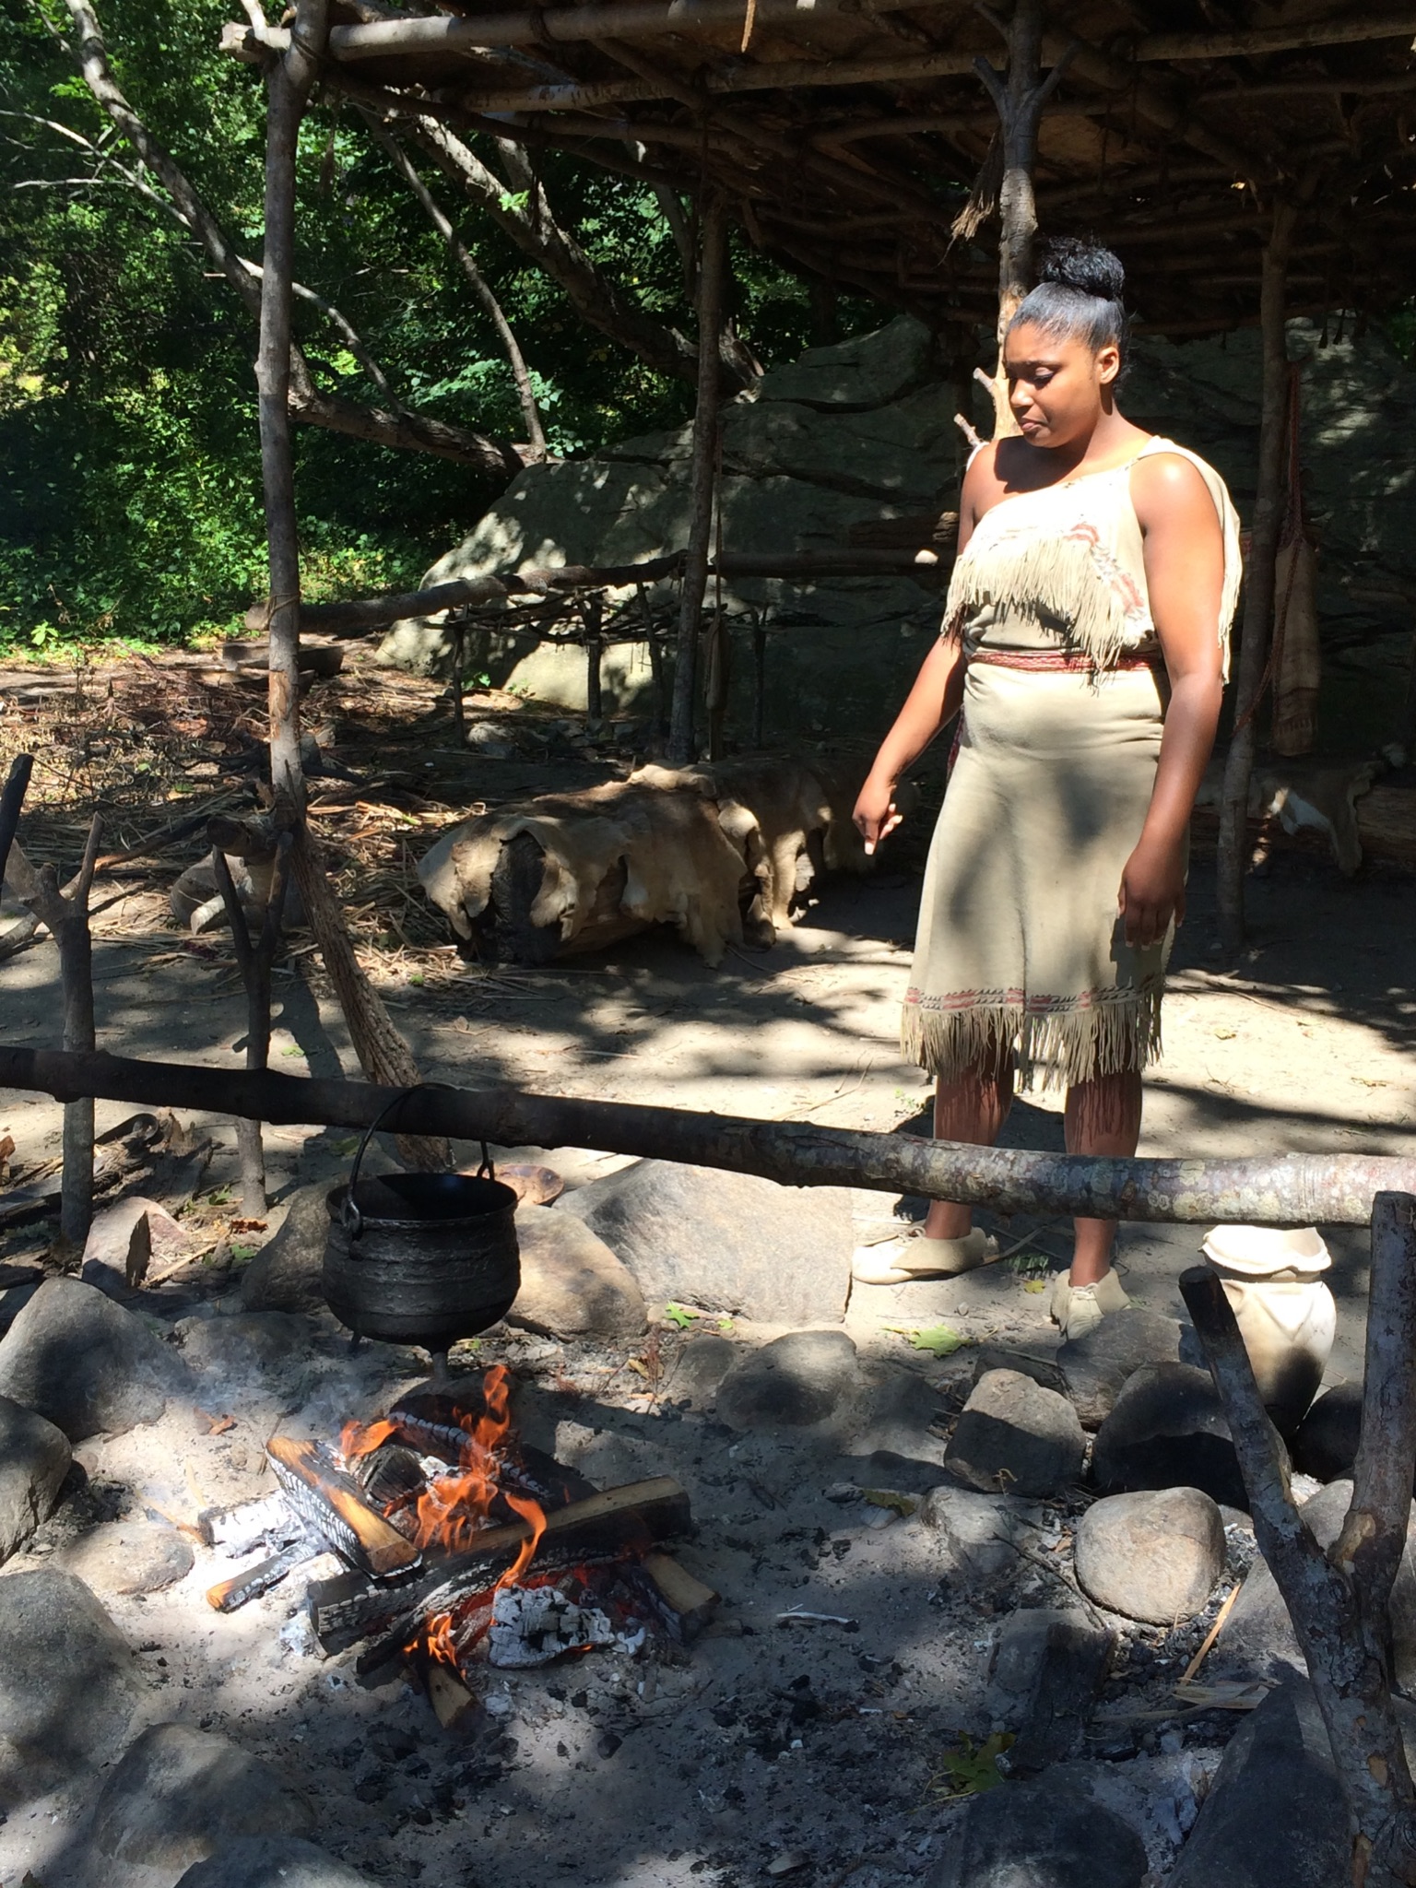
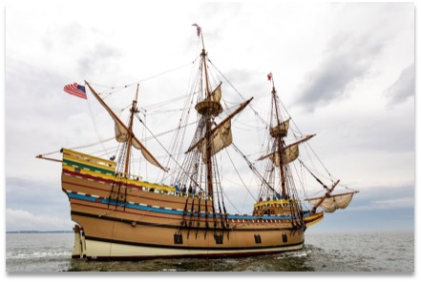
Plimoth & Patuxet Museums feature villages of Pilgrims and Native People. They employ people to dress and work as people did in the 1620s.
Plymouth, Massachusetts
The Mayflower II is a replica of the Mayflower. It was built in 1955-56 and was restored in 2020. It can be visited in Plymouth Harbor.
Notes:
Today there are over 300 million people in America. Some of our ancestors are native to this land, but most came from other countries. It is important to remember that just 50 Pilgrims survived the winter of 1621 with the help of the Native People and were able to begin to build a nation.
35 million people are descended from the 50 Pilgrim survivors. Maybe you are one of them! Someday you might visit the Mayflower II and the living museum that shows how the Pilgrims and Native People lived in the 1620s.

Slide 34
Written and compiled by Lindsay Kamm, HSMD Secretary, 2021
Notes:
Please see Discussion Questions, Resources, and Citations:
Discussion Questions for 400 Years after the First Thanksgiving
1. The desire for religious freedom played a big part in convincing some people to leave England for America. What do you understand about this important part of history?
2. How did the Pilgrims know anything at all about America?
Maps
Explorers
Traders
3. Why were merchants interested in America?
They wanted natural resources such as fish, lumber, and beaver furs that would sell in England.
4. What problems did the Mayflower encounter on the voyage to America?
Late start – not a good time of year to cross the Atlantic
Storms
Conflict between the two groups of settlers
Sickness among the passengers
Off course – unknown territory
Winter arrival
5. What is the importance of the Mayflower Compact?
It had ideas about making laws and electing leaders that were different from England.
It kept the people together even though they had differences so they had a chance to survive.
6. What happened in the first few months after the landing at Plymouth?
Half the men, women and children died.
They built a few structures
They met the Native People.
7. Why did the Native People befriend the Pilgrims?
They needed military support.
8. What did the Pilgrims celebrate at Thanksgiving?
Harvest of crops
Bountiful wildlife
Survival of those who survived
Friendship and support of the Indians
God’s blessings and guidance
The life of their community and hope for the future
Resources for 400 Years After the First Thanksgiving
CHILDREN’S BOOKS
All are available at Amazon and some at www.plimoth.org
Don’t Know Much about the Pilgrims by Kenneth Davis
Eating the Plates by Lucille Penner
Giving Thanks “The 1621 Harvest Feast” by Kate Waters
If You Sailed on the Mayflower in 1620 by Ann McGovern, 1991
Mayflower 1620: A New Look at a Pilgrim Voyage
by Sisse Brimberg
Pilgrims of Plymouth by Susan E. Goodman
The Mayflower and the Pilgrims’ New World
by Nathaniel Philbrick
The Mayflower Compact by Elizabeth Raum
The New Americans: Colonial Times 1620-1689
by Betsy Maestro & Giulio Maestro
Three Young Pilgrims by Kenneth Davis
TEACHER RESOURCES
1621 A New Look at Thanksgiving, Catherine O’Neill Grace, National Geographic, 2004.
Commemorating the 400th Anniversary of the Mayflower Compact – Video
2 min 52 sec at www.plimoth.org
Cut & Assemble the Mayflower: A Full Color Paper Model $18.95 (www.plimoth.org)
Don’t Know Much About the Pilgrims, Kenneth C. Davis
Mayflower 1620, National Geographic, 2007.
Mayflower Compact Poster (www.plimoth.org) $8.00
Mayflower Sails! Video shows the restored Mayflower II arriving in Plymouth Harbor in 2020
2 min 20 sec at www.plimoth.org
Mourt’s Relation (A Journal of the Pilgrims at Plymouth first published in 1622)
Introduction by Dwight B. Heath
Of Plymouth Plantation 1620-1647, William Bradford
Pilgrim Hall Museum (pilgrimhall.org)
Plimoth & Patuxet Museums (www.plimoth.org)
The First Thanksgiving Teacher’s Activity Guide, Scholastic Education Solutions.
Citations for 400 Years After the First Thanksgiving
Credits & Citations for Images by Slide #
1. November Turkey. Cliparts.com
2. Children at Thanksgiving. Shutterstock.
3. Perfect 10 Map of New England. UNLV.
4. Ferris, Jean Leon Gerome, Artist. “The First Thanksgiving 1621.” Shutterstock.com
5. Photo of Native Man. Lindsay Kamm, 2014.
6. Photo of Massosoit Statue. Lindsay Kamm, 2014
7. Map of New England – published in Mercator’s ‘Historia Mundi,’ 1635. With portrait of Captain John Smith. Alamy.com
8. None
9. “1814 Thomson Map of the Atlantic Ocean.” Wikimedia.
10. The Holy Bible: King James Version: 1611 Edition. Hendrickson Bibles.
11. Photo of Duxbury Beach. Lindsay Kamm, 2017.
12. “Mayflower,” a drawing from Harper’s Young People, 3 Feb 1880. Reusableart.com
13. Details from Antique 1856 engraving from "Landing of the Pilgrim Fathers" by Charles Lucy (1814-1873). SOURCE: ORIGINAL STEEL ENGRAVING. Alamy.com
14. Southern California News Group. Sources include: mayflowerhistory.com, National Geographic, Teaching and Learning Co., History Channel, Wikipedia.org., plimothplantation.org,
15. “The Mayflower at Sea 1620,” Hand-colored woodcut. Alamy.com.
16. “Journey on the Mayflower.” The First Thanksgiving Teacher’s Activity Guide. Scholastic Education Solutions.
17. “Area of Massachusetts Circa 1677.” Voices from Colonial America: Massachusetts, 1620-1776, National Geographic Society © 2007
18. Ferris, Jean Leon Gerome, Artist. The Mayflower Compact/ J.L.G. Ferris. Photograph. Wikipedia Commons.org
19. Image of the handwritten record of The Mayflower Compact. Mass.gov.
20. Antique 1856 engraving from "Landing of the Pilgrim Fathers" by Charles Lucy (1814-1873). SOURCE: ORIGINAL STEEL ENGRAVING. Alamy.com
21. Photo of Monument End. Lindsay Kamm, 2017.
22. Photo of Monument Names. Lindsay Kamm, 2017.
23. Photo of Monument Face. Lynda Hylander, 2017.
24. “The Old Fort and First Meeting House, 1621, Plymouth, Mass.,” postcard. A. S. Burbank, Plymouth, Mass. Alamy.com
25. Photo of Site of First Fort. Lindsay Kamm, 2014.
26. “Interview of Samoset with the Pilgrims,” book engraving. Alamy.com
27. Photo of Massasoit Statue. Lindsay Kamm, 2014.
28. Native Americans Harvesting Maize, hand colored woodcut. Alamy.com.
29. Ferris, Jean Leon Gerome, Artist. “The First Thanksgiving 1621.” Shutterstock.com
30. Indian Corn Stock Image. Shutterstock.com
31. Governor William Bradford (1590-1657) English Puritan who emigrated on board the Mayflower in 1620 and founded the Plymouth Colony in the New World. Photograph of illustration by A.S. Burbank. Alamy.com
32. Image #1411827098. Shutterstock.com
33. Photos of Plimoth Patuxet Museums Interpreters. Lindsay Kamm, 2017. Photo of Mayflower II. Lynda Hylander, 2020.
34. Website banner of The Hawaii Society of Mayflower Descendants.

